Slide 2
Chapter 1: Introduction
Part A: Core Concepts
Part B: The Practicalities
Rationale, Scope and Background of Cultural Risk Assessment and CIERA
Chapter 2:
Chapter 8:
Cultural Risk Assessment & The Cultural Inclusivity and Equity Risk Assessment (CIERA)
Chapter 3: Cultural Risk – EEDI and Bias
Activating Theory -
England and Wales Cricket Board
Chapter 9:
Chapter 4: The Science of Inclusion and Bias
Managing Organisational Risk: Integrating Cultural Risk Awareness into Corporate Governance
Chapter 10:
Chapter 5: Culture
Chapter 11:
Comparing faith in cultural contexts: In Sacred Spaces and on the Dancefloor
Chapter 6: Theories and Frameworks
Chapter 12:
Activating Theory - Action Research with Faith Leaders for the British Ritual Innovation in COVID
Chapter 7: Cultural Intelligence (CQ)
Chapter 13:
Between the lines -
Conversations in Context, a Dialogical Approach
Part C: Case Studies
CS 1: Sweden – Religious Heritage
CS 10: UK – Faith and Sexuality
CS 2: UK – Sensory Rooms
CS 6: Qatar – Football World Cup
CS 11: UK – Cultural Events
CS 3: England – Prom Events
CS 7: USA – NFL
CS 12: USA – Belonging and Ethnicity
CS 4: UAE – Cultural Awareness
CS 8: Japan – Cultural Heritage
CS 13: Caribbean – Diaspora Communities
CS 5: Australia – Indigenous Communities
CS 9: UK – Sport and Gender
CS 14: Nigeria – Business Events

Slide 3
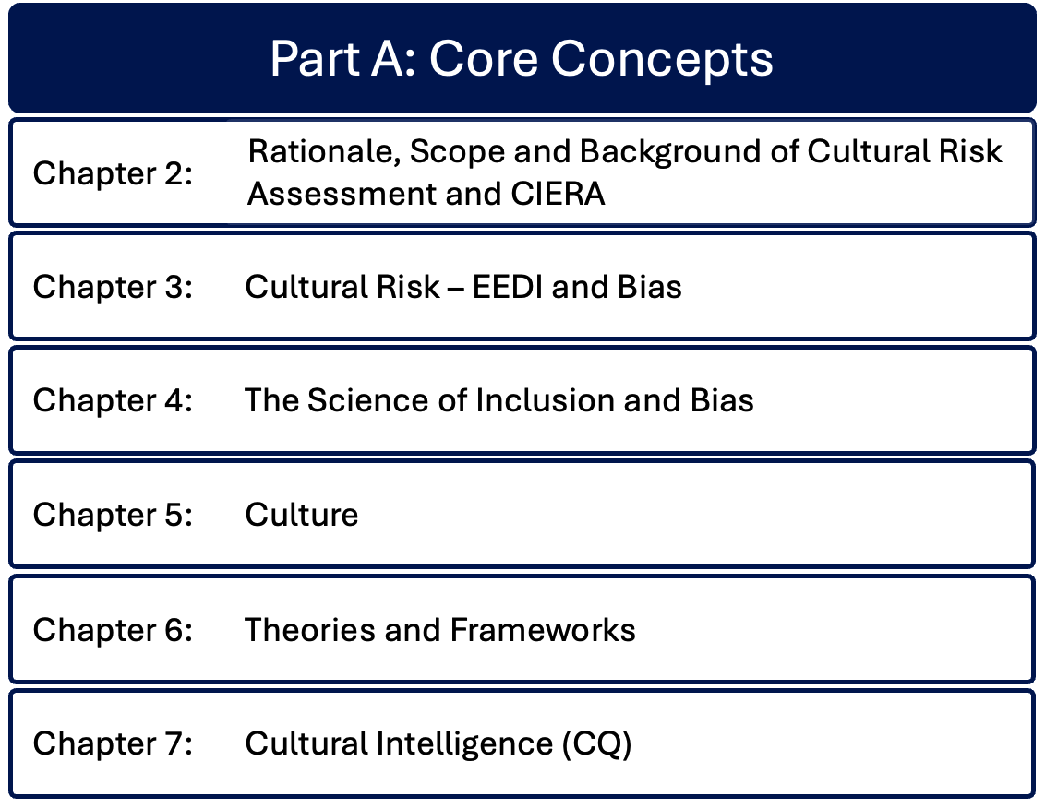

Slide 4
Chapter 6: Theories and frameworks
Bernadette Albert
Examines key theoretical frameworks of culture, developing an understanding of culture by addressing frequently utilised frameworks like the cultural web and the cultural iceberg, transitioning to more complex theories: Hofstede’s cultural dimension theories and Hall’s high and low context cultures.
Unpacks Bourdieu’s theory of cultural capital and space navigation, as social positioning and knowledge influence and shape cultural opportunities and interactions.

Slide 5
Introduction
Applies key theoretical concepts that explore how culture shapes events in a super-diverse society
Impacts event management elements - planning, audience engagement, content delivery – to limit risks
  Cultural dimension theories
  High and low context cultures
  Cultural iceberg
  7 dimensions of culture
  Theory of basic values
  Concept of cultural competence
  Habitus

Slide 6
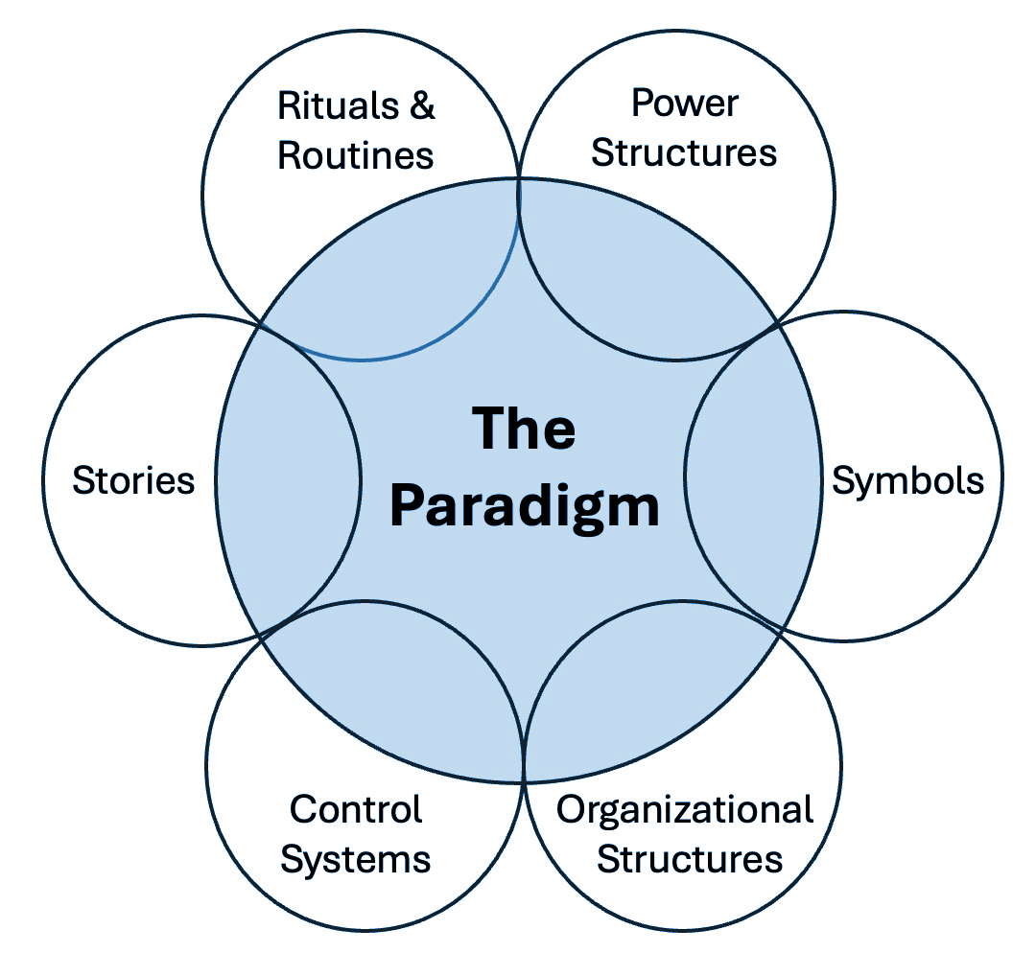
The Cultural Web (adapted from Johnson, Whittington & Scholes, 2023)
Presents a social paradigm that represents collective identity and assumptions that define group cultural identity
Application to events can facilitate social cohesion, preserve cultural heritage and enable navigation of social and event spaces
Key to developing our own cultural competence

Slide 7
Hofstede’s Cultural Dimension theories
Enables development of view of cultural preference and behaviours
Enhances communication for smoother interactions
Understanding is key to navigating cross-cultural event situations
Power-Distance Index
Collectivism vs Individualism
Masculinity vs Femininity
Uncertainty Avoidance Index
Long-term vs Short-term orientation
Indulgence vs Restraint

Slide 8
Hofstede
Power Distance Index
Collectivism vs Individualism
Identifies the extent to which less powerful members of a society accept or expect the distribution of power within that context
E.g. former caste systems, family structures class
Low power index societies have more equal distribution of power – consultation, active involvement, feedback
Focus on whether persons act as individuals or as part of a wider group
‘I’ / ‘Me’, individual achievements and rights
Group loyalty, cohesion, community relationships – tend to be more averse to conflict

Slide 9
Hofstede
Masculinity vs Femininity
Uncertainty Avoidance Index
Gender role differentiation – values placed on normative ‘traditional’ gender roles
Expectations regarding flexible working, child care in masculine societies – have male heads of households, seen as providers
Low femininity scores – fewer social requirements to family stereotypes, higher rates of female leadership and entrepreneurship
Measures a society’s ability to cope with change, or the level of threat change poses
Low uncertainty cultures navigate unstructured situations more comfortably
Especially relevant in events to levels of planning and regulation and adapting to change

Slide 10
Hofstede
Long-term vs Short-term orientation
Indulgence vs restraint
Does culture value
Future rewards, strategic planning and perseverance (Long-term)
vs
Immediate results, pressure to conform to existing norms (Short-term)
A recent addition
Level of societal impulse and desire control
High indulgence societies prioritise luxury, happiness, personal freedom
Low indulgence societies have restraint culture, tend to suppress gratification through social norms, stricter moral or religious codes, fewer public expressions of emotion

Slide 11
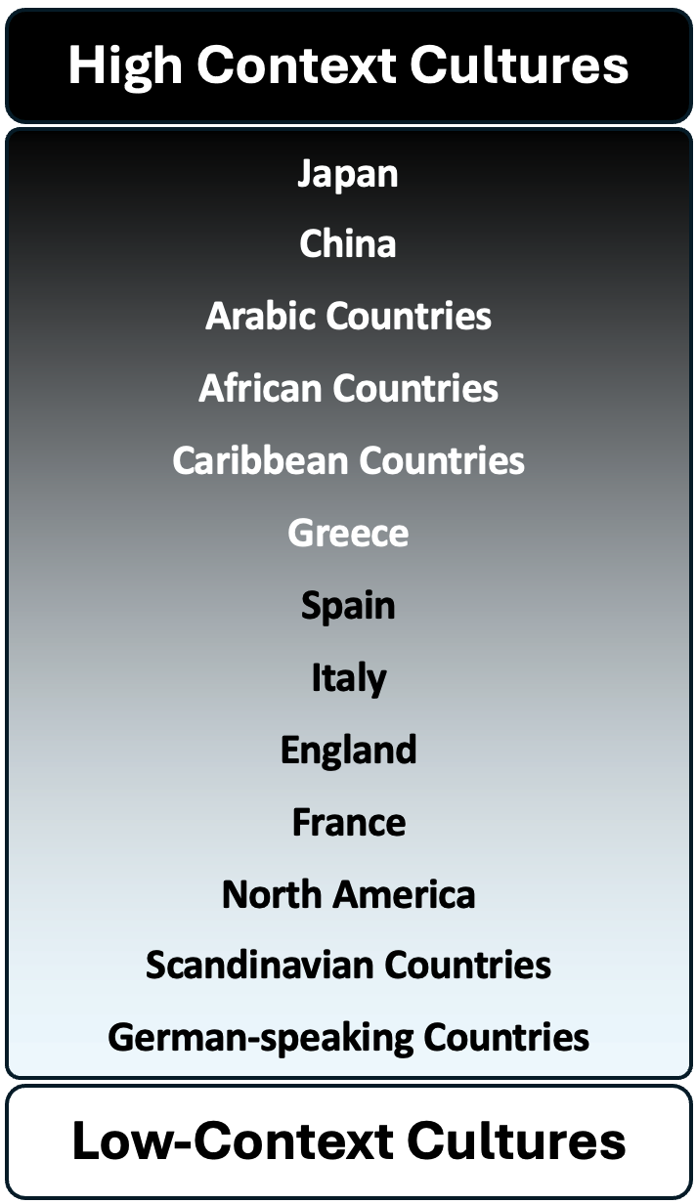
Hall’s Cultural theories
High and Low Context cultures
Characterises culture in terms of communication styles – verbal and non-verbal
High context relies on non-verbal cues, deep implicit cultural knowledge – prioritise harmony, group relationships, understanding beyond words
Low context value efficiency, clarity
Vital for creating culturally inclusive multicultural and global events

Slide 12
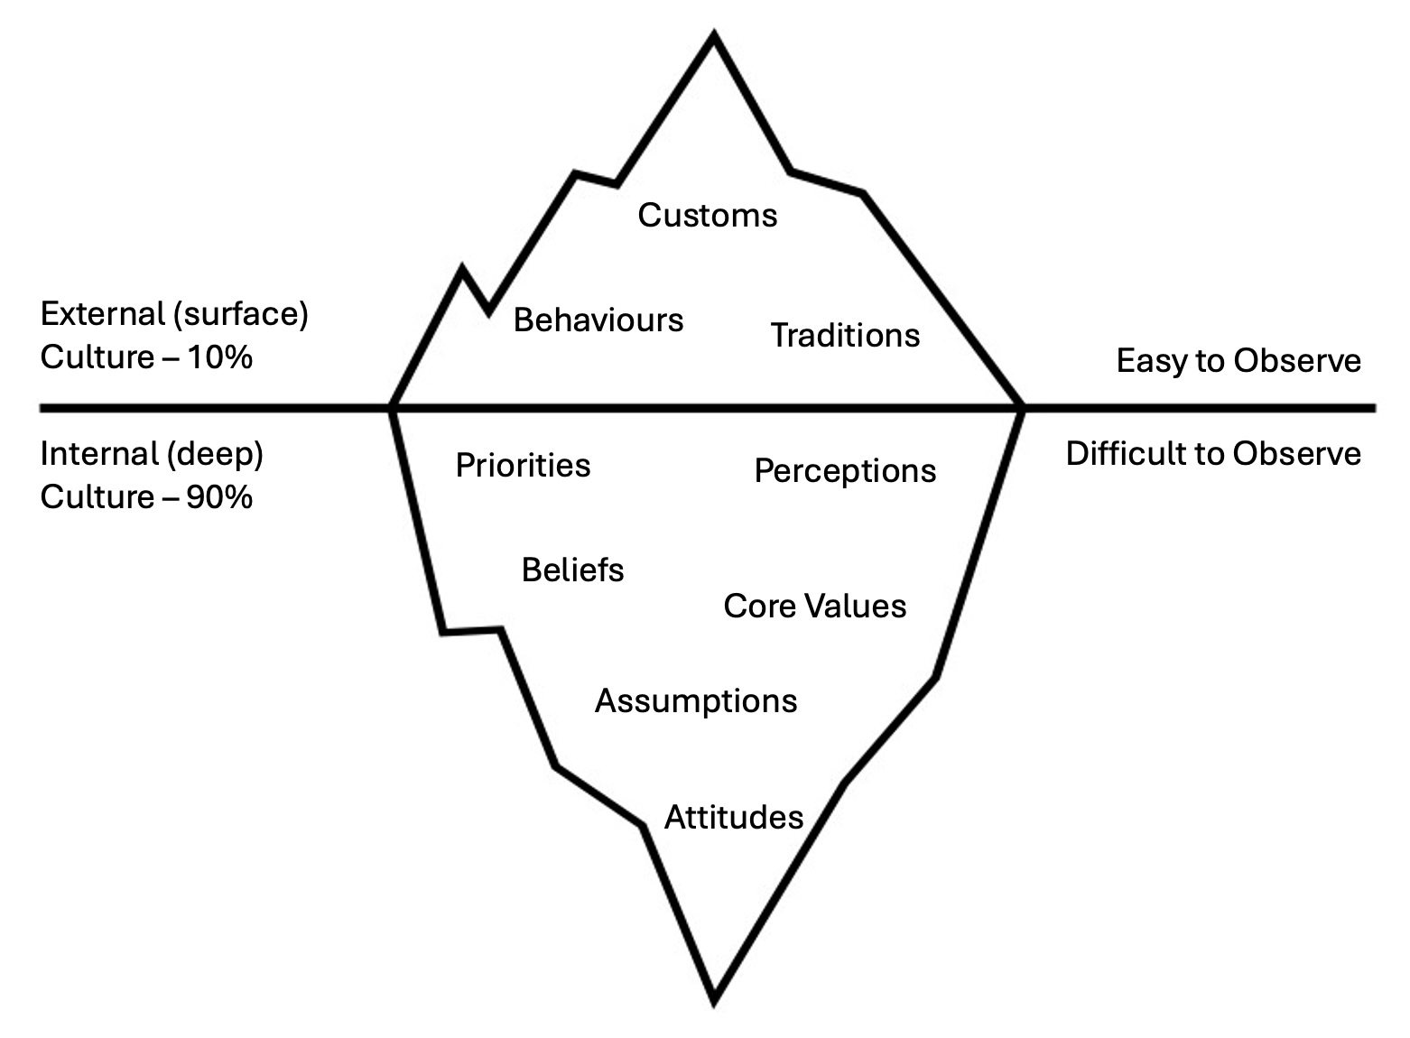
Hall’s Cultural Theories
The Cultural Iceberg
Demonstrates complexity of visible and hidden aspects of culture
Critical to managing cultural risk
Proxemics – differences in the use of space, including the size of personal space

Slide 13
Bourdieu’s theory of Cultural Capital
Explains how individual cultural knowledge, experiences and taste can contribute to social mobility and status attainment
Diverse Workforces and events, (especially large-space and global) – high cultural capital is becoming a requirement to enable inclusive event management and planning as well as social mobility, educational attainment, career prospects
Embodied – internalised practices, skills, knowledge
Objectified – exposure to tangible objects e.g. books, musical instruments, food
Institutionalised – gained through formal qualifications e.g degrees
Online – digital literacy and access

Slide 14
Summary
Theoretical models can help event managers to identify critical elements and dimensions of culture in order to create culturally inclusive spaces and events
Being able to understand the complex nature of culture beyond the surface levels is a key skill for event managers

Slide 15
Discussion Questions
How can Hofstede’s cultural dimensions support you to design culturally inclusive events that cater to diverse audiences?
What strategies could be implemented to navigate high and low contexts communication styles when planning an international event?
How can increasing your cultural capital improve your professional success in events?
How does understanding the cultural iceberg support event managers addressing hidden cultural expectations and potential challenges?
Using a business meeting with an international client, give an example of something you would consider from the lower part of the iceberg.

